Slide 1
Samantha and robotc
By mark raymond jr.

Slide 2
About me
Pattonville High School
Green Army Robotics Team 2867 (Armored Division)
Programmer (Troubleshooter)
I’m a Mac.
Notes:
I’m a Sophomore.
When I was a freshman, coded very little ,so, I took up learning the ins and outs of everything else, this year I’ve changed that.
I wanted to give people a crash course in Samantha because it’s confusing.
A lot of information.
Pitchforks and Torches.

Slide 3
Why are we here?
Learn about the methods for connectivity between your Robot and RobotC.
USB
Bluetooth
WiFi
Learn how to connect to your Robot using RobotC.
Samantha Module
Notes:
Some Disadvantages and Advantages of both.
I’m going to go through the first few methods pretty quickly, and spend a large amount of time on Samantha, and I’ll take questions whenever.

Slide 4
Connecting to the robot
3 methods

Slide 5
usb

Slide 6
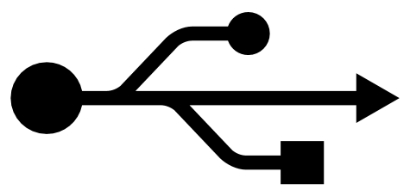
Why use usb?
Reliability
Ease of Use
Notes:
You can always count on USB to work, unless something major is wrong with the Robot or the Computer.
And if you can’t use USB, something is wrong.

Slide 7
Why not use usb?
Wired
Notes:
Wired! That’s the biggest problem with USB and why you can’t use it at the competition.

Slide 8
Demo

Slide 9
Bluetooth

Slide 10

Why use bluetooth?
Semi-Reliability
Wireless

Slide 11
Why not use bluetooth?
Short Range Wireless
Not usable during a competition.
Notes:
Not really allowed during a competition.
Not every computer comes with a Bluetooth adapter.
Wireless, but you again can’t roam the halls controlling the Robot, because Bluetooth is meant for short range wireless connectivity. You may only get about 10 to 20 feet before the connection is lost.

Slide 12
Demo

Slide 13
Wifi and samantha

Slide 14

Why use wifi?
Long range wireless connection.
Very reliable (Samantha Module)
Notes:
Long range wireless technology.
Whilst WiFi is very reliable, the Samantha module is often not.

Slide 15
Wifi - Samantha module
The Samantha Module is currently the only way to connect wirelessly (over WiFi) to the NXT.
Has it’s own firmware independent of the NXT.
Requires a nice amount of setup.
Notes:
Background on it.
The setup at sometimes can seem daunting.

Slide 16
WiFI – samantha module
First, we’ll make sure that the firmware on the NXT is up to date.
Then, install all of the FTC Field Control Software. Found here.
Create your wireless network, and make a configuration file using the software.
You’ll need a flash drive at this point, 4GB or smaller. To flash the firmware to the Samantha.
Notes:
Formatted as FAT32.
You can use an ad-hoc (computer to computer) network with Samantha, but this is the most common setup.

Slide 17
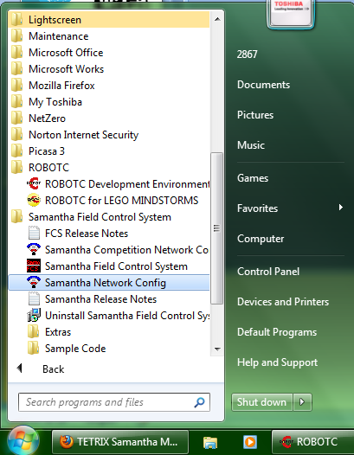
WiFI – samantha module

Slide 18
Demo

Slide 19
Flashing the firmware
Unplug the USB flash drive from your computer and (plug it into the Samantha Module.
2. Plug in the battery while holding down the red/black button on top of the module. Release the button approximately 3 seconds after the red light appears on the module.
3 . The Samantha Module will flash the red light twice in rapid succession and then flash the white repeatedly. You may also see the flash drive's LED flickering (if applicable). This means the Samantha Module is installing the firmware. When it's done, it will flash the red, white, and blue lights in sequence, then repeat the process. Be patient; this process normally takes 20-30 seconds and as long as 2-3 minutes. When it is done it should have a solid red light and a blinking white light (meaning it is connected to the network).

Slide 20
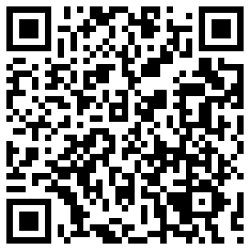
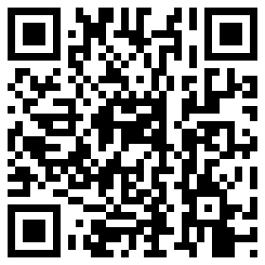
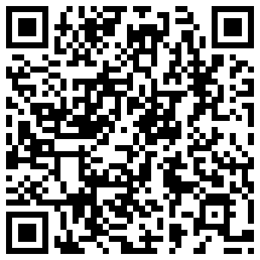
USEFUL SITES

